Slide 1
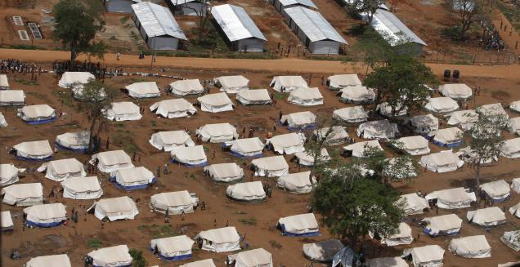
Resettlement and Rehabilitation

Slide 2
Causes for Displacement of People
Due to developmental activities.
Dam Constructions
Loss of forests.
Water logging.
Possibility of earth quake.
Due to natural Disaster
Natural
Man made
Due to conservation initiatives

Slide 3
Resettlement
It is relocation of human population.
Process does not focus on their future welfare.

Slide 4
Rehabilitation
Rehabilitation involves making the system to work again by allowing the system function naturally.
It includes replacing lost economic assets.
Safeguard employment.
Provide safe land for building.
Restore social service.
Repair damaged infrastructure.

Slide 5
Problems in Rehabilitation
Tribal People lost their job and leads to poverty.
Disintegration of families.
Social readapting problem with new trends.
Loss of people’s identities.

Slide 6
Rehabilitation policy
Detailed study of problems before the project starts.
Resettlement and Rehabilitation must be part of project work.
Rehabilitation must be minimum dislocation basis.
Native people must get benefit from project.

